Slide 1
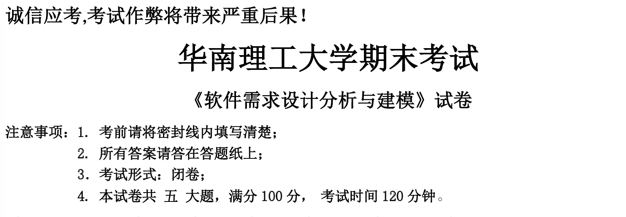

宣讲人：郑凯文（22级软件工程卓越班）
宣讲时间：2024年6月16日 星期日 15:00 — 17:00
考试时间：2024年6月18日 星期二 08:50 — 10:50

Slide 2
目 录
第一章 GRASP 设计模式
第二章 GoF 设计模式
第三章 UML 软件设计分析与建模
第四章 历年常考简答题精选
第五章 软考真题荟萃（解答题）
第六章 软考真题荟萃（选择题）

Slide 3
第一章 GRASP 设计模式
General Responsibility Assignment Software Patterns
第一节 Controller（控制器 —— MVC）
第二节 Information Expert（信息专家）
第三节 High Cohesion & Low Coupling（高内聚、低耦合）
第四节 Indirection（间接模式）

Slide 4
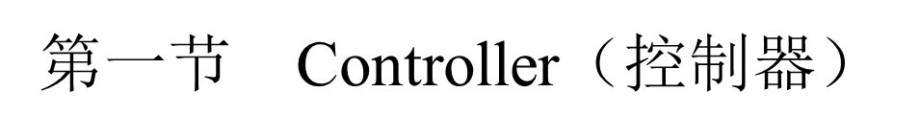
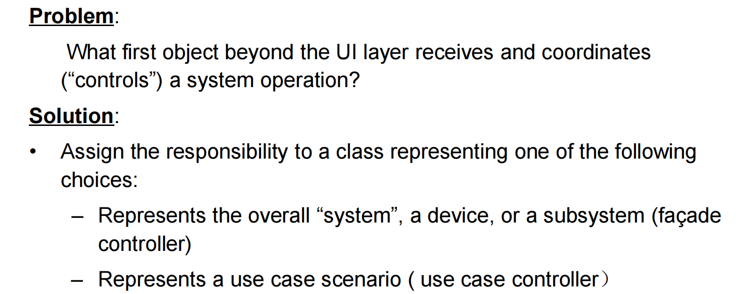
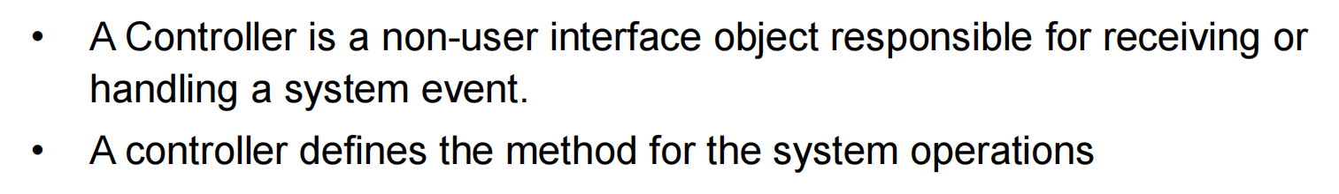

Slide 5
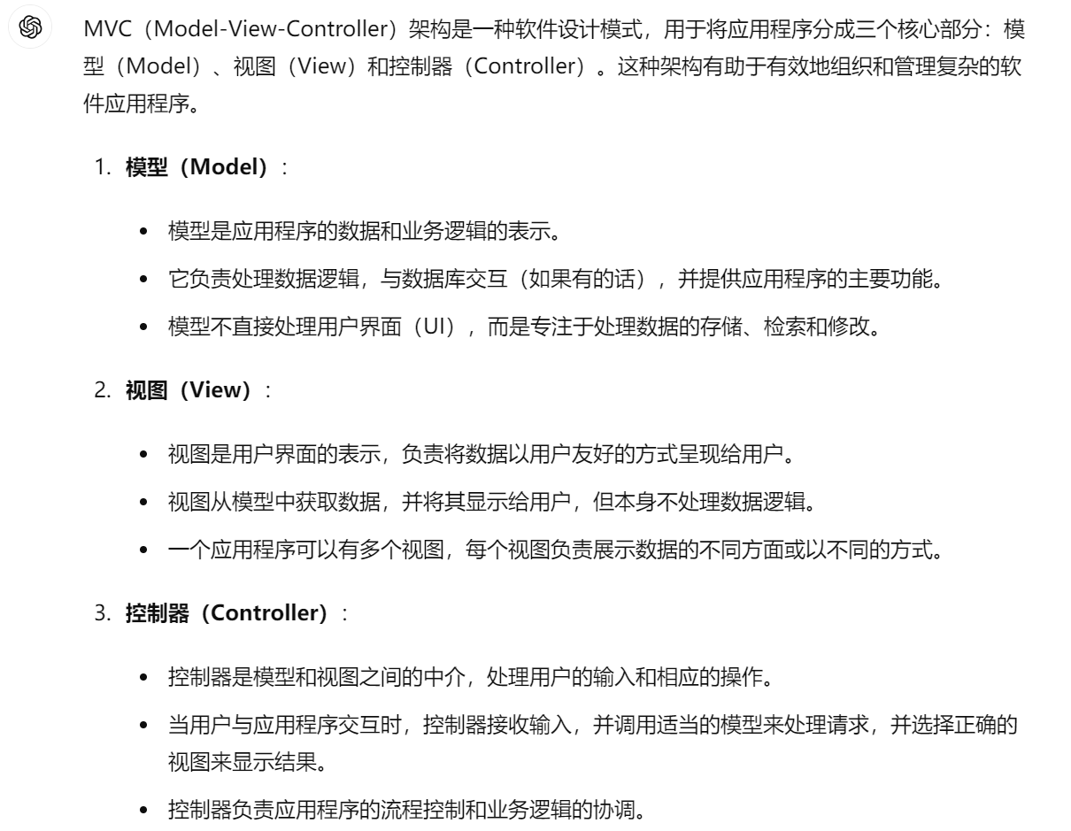
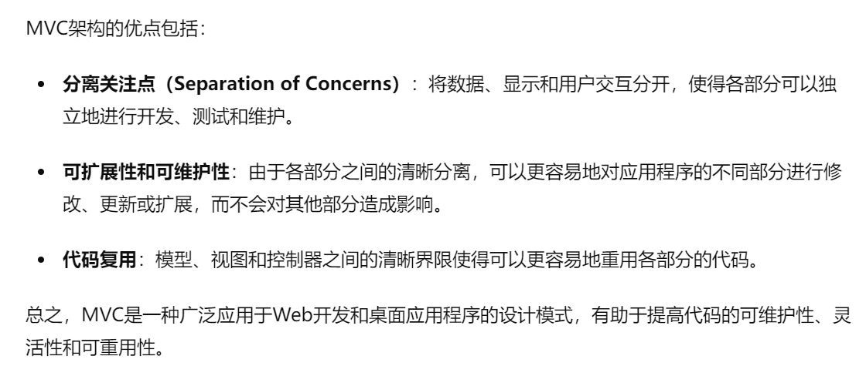
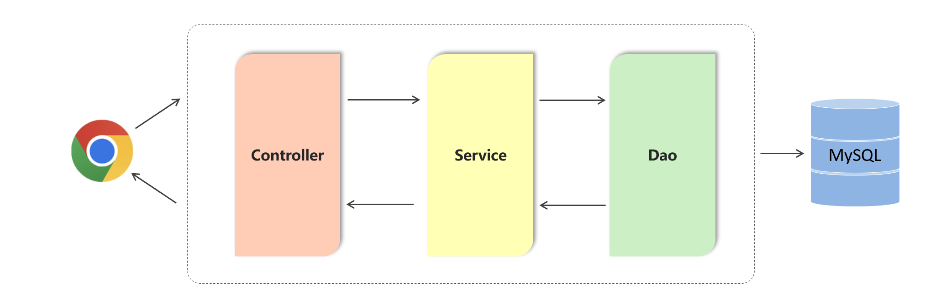

Slide 6
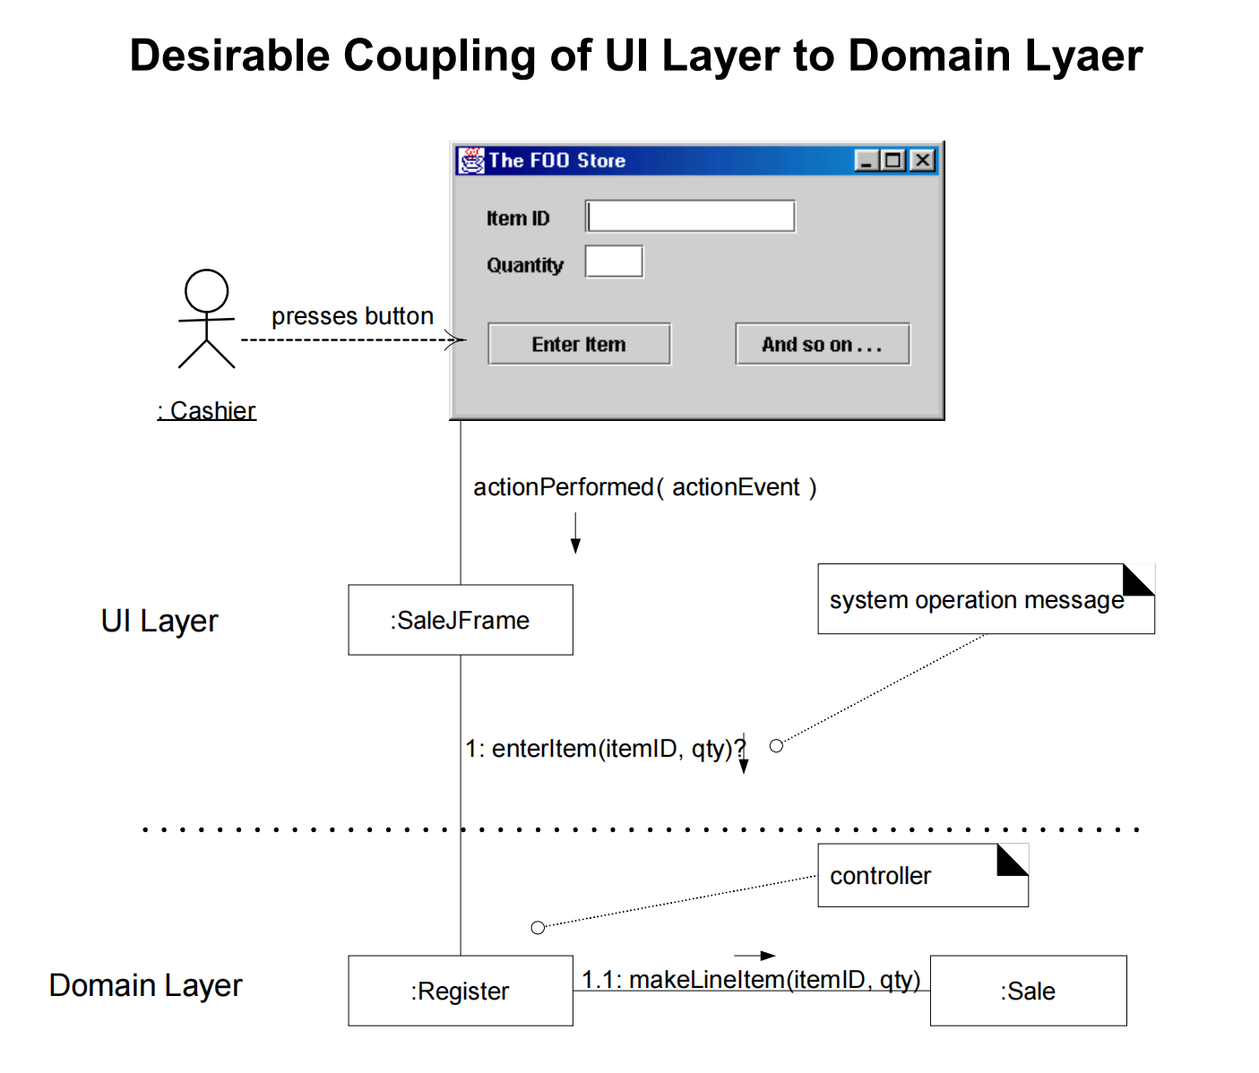

Slide 7
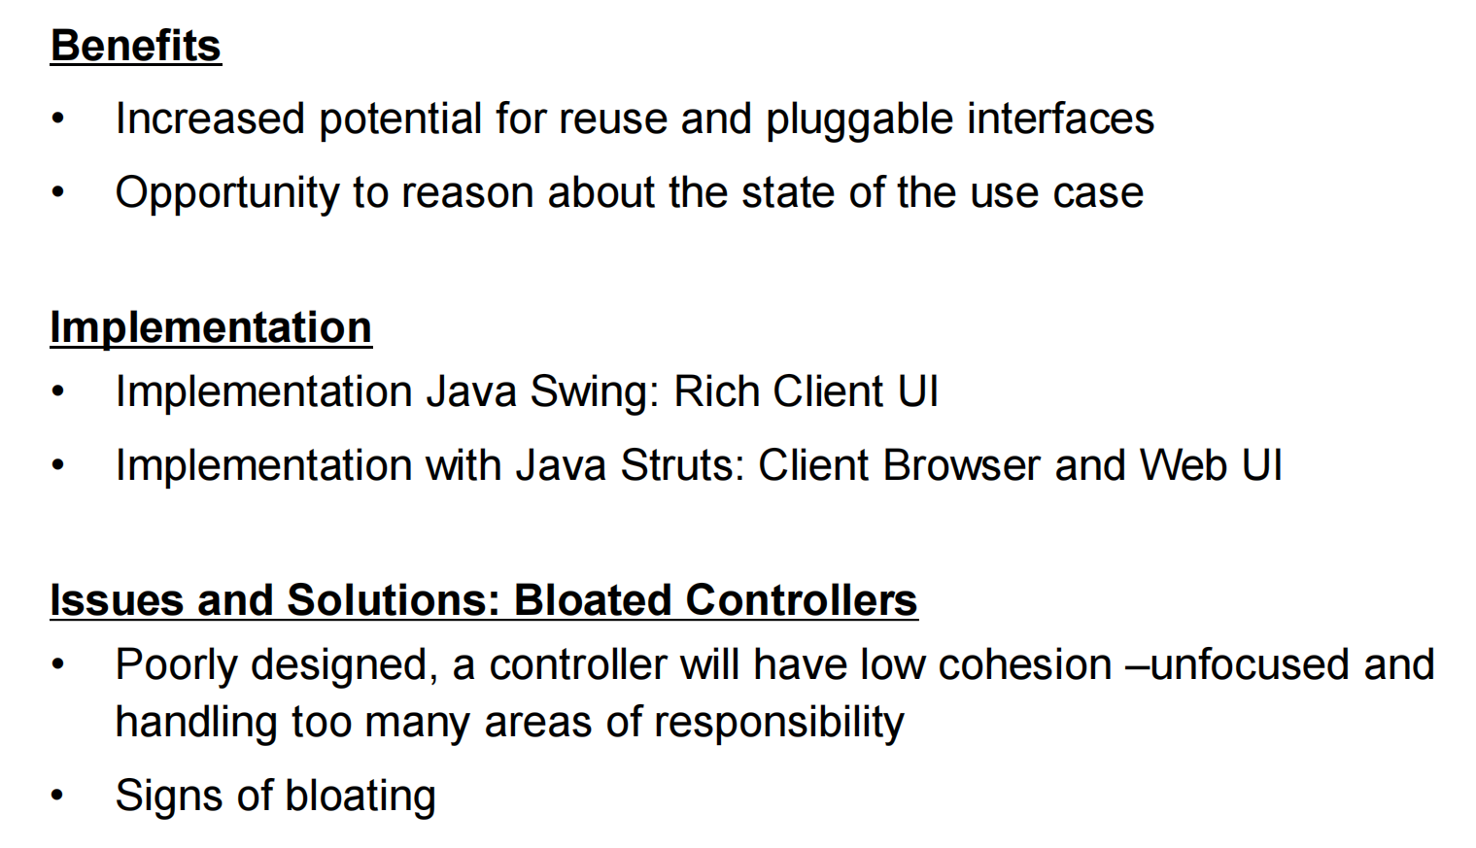

Slide 8
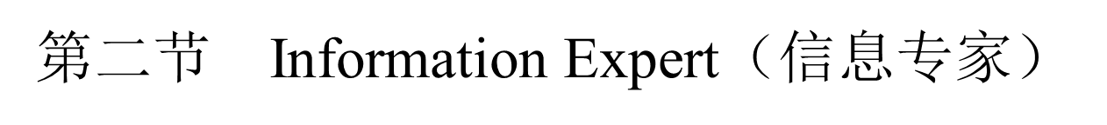
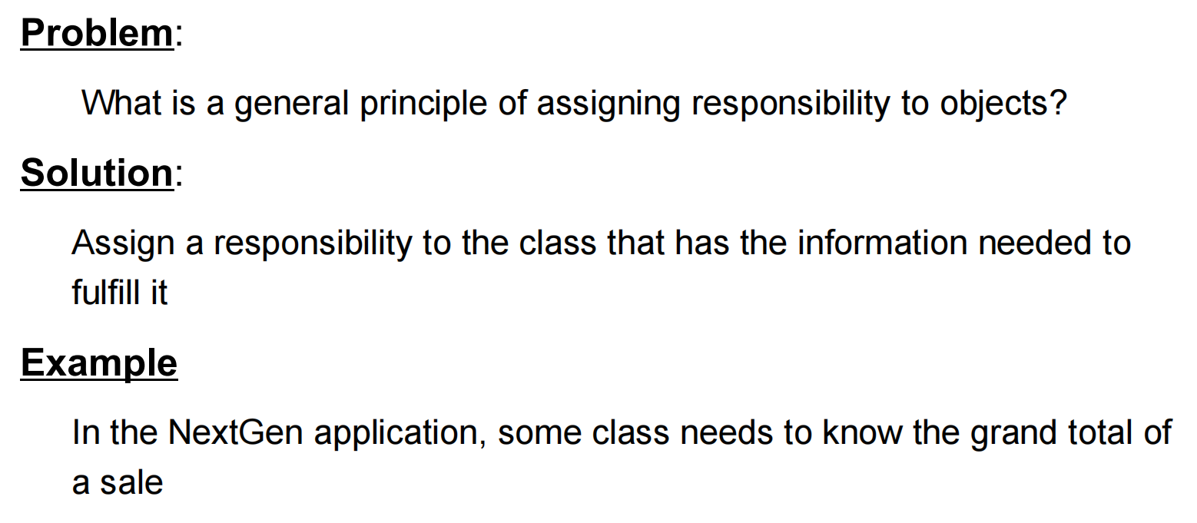

Slide 9
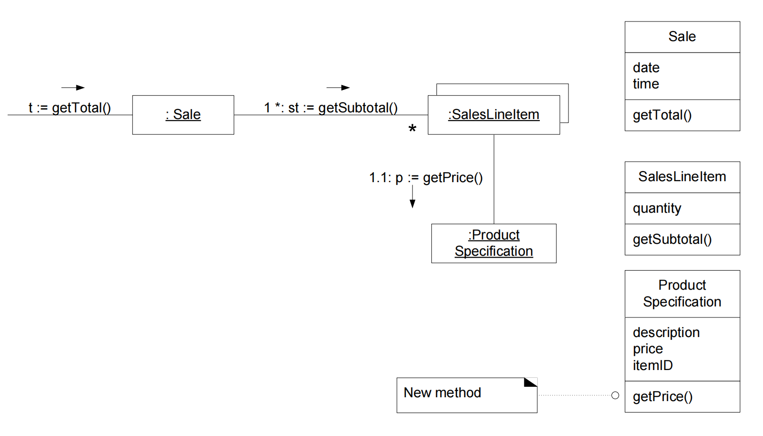

Slide 10
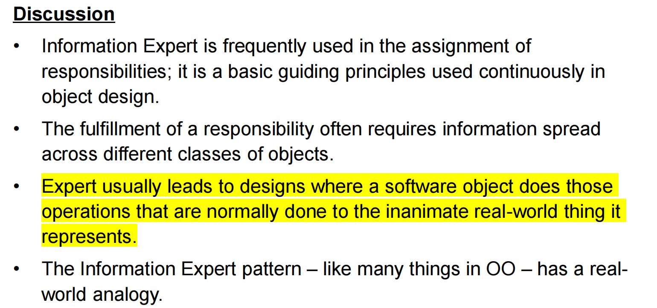

Slide 11
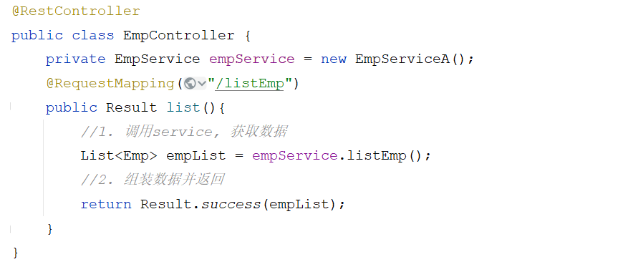
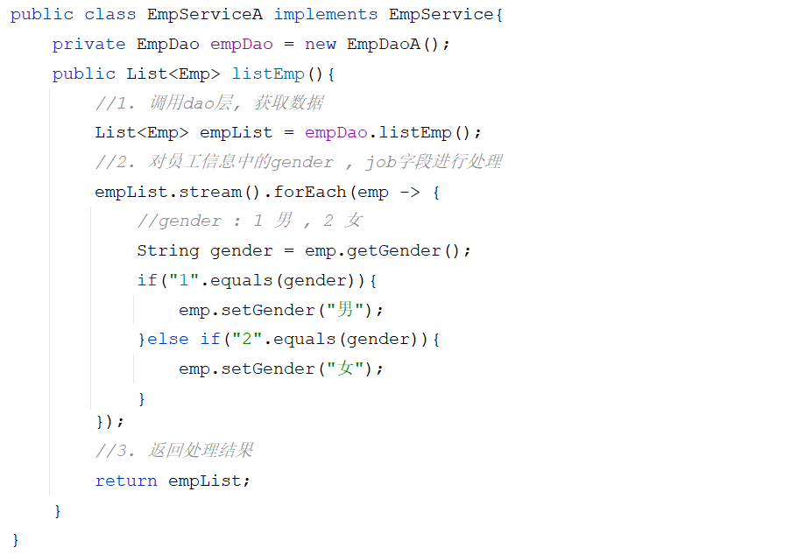

分层解耦
内聚：软件中各个功能模块内部的功能联系。
耦合：衡量软件中各个层/模块之间的依赖、关联的程度。
软件设计原则：高内聚低耦合。
controller层
controller
service
dao
service层

Slide 12
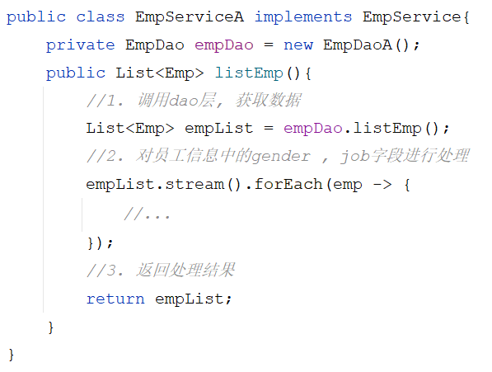
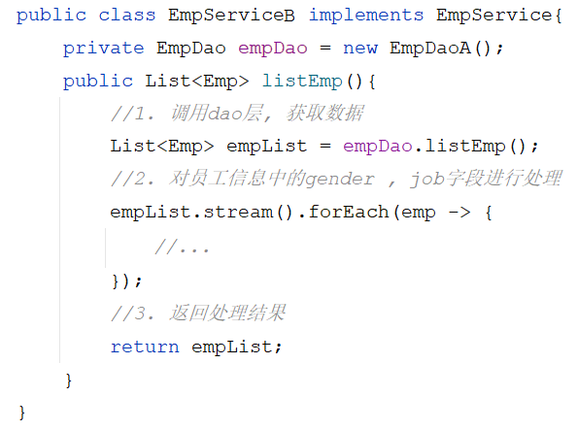
分层解耦
耦合
controller层
service层

Slide 13



分层解耦
B
A
EmpService
A
A
B
B
容器

Slide 14
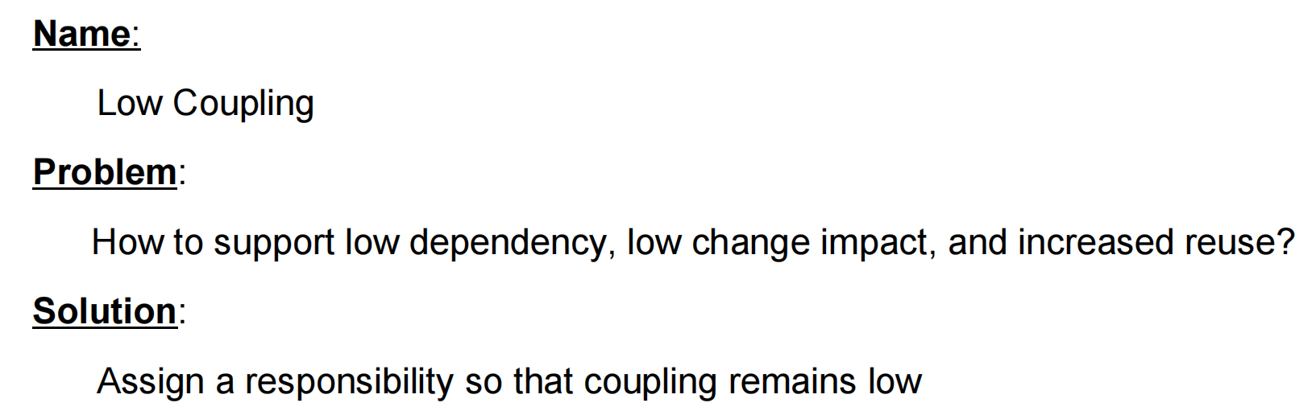
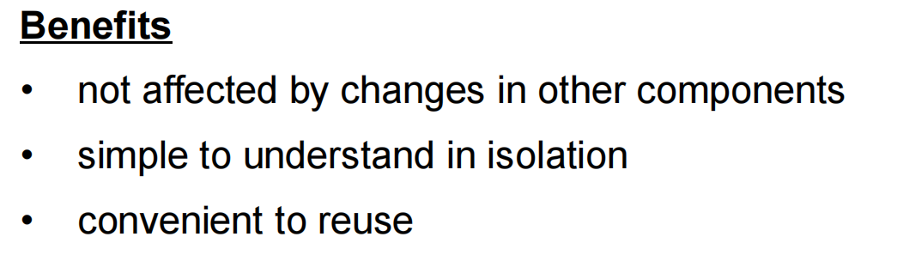

Slide 15
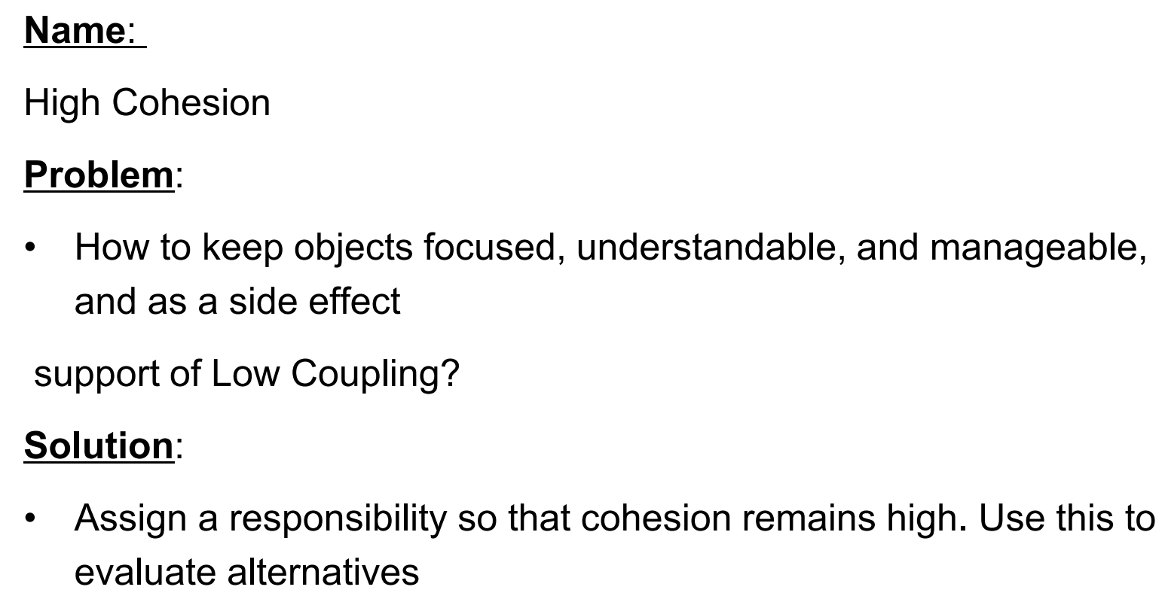

Slide 16
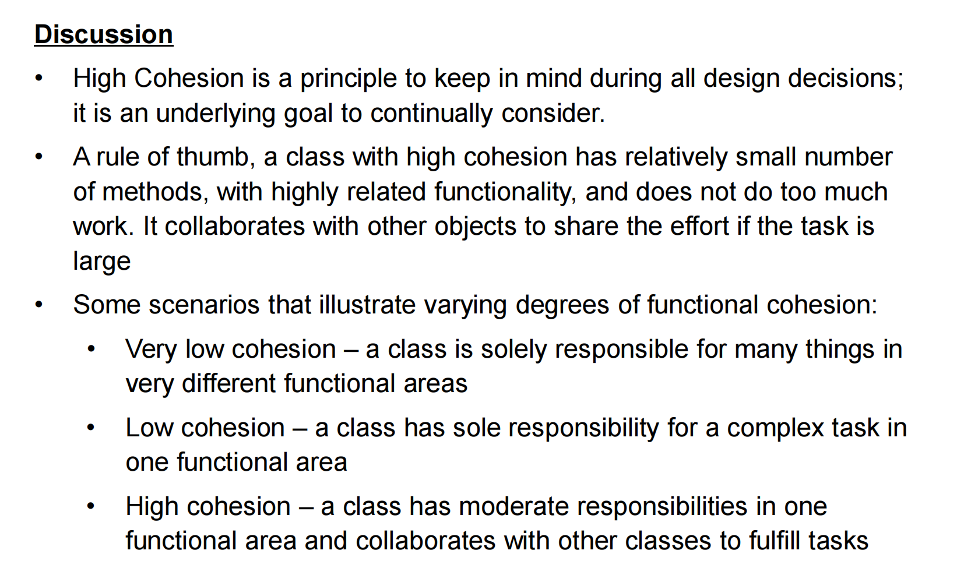

Slide 17
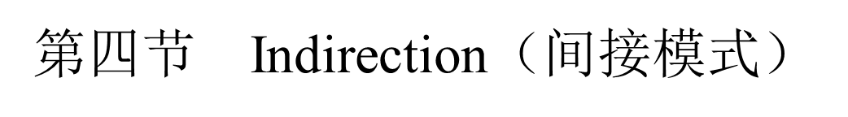
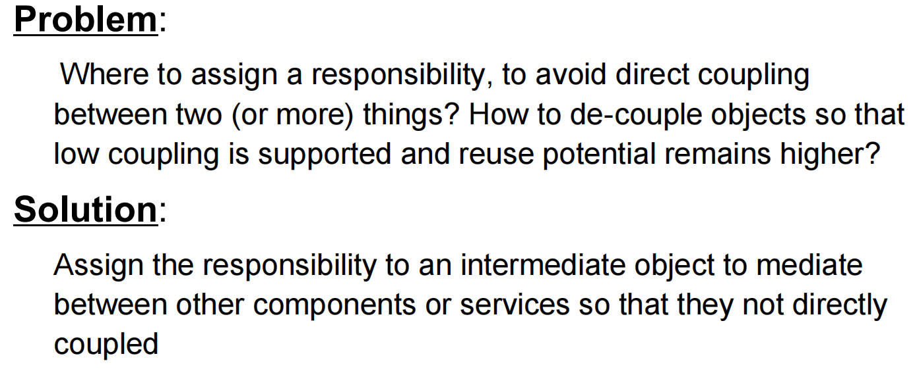
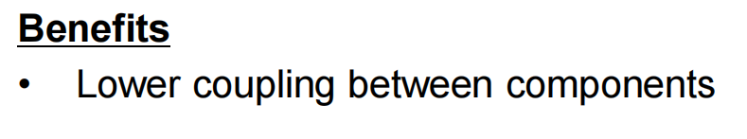

Slide 18
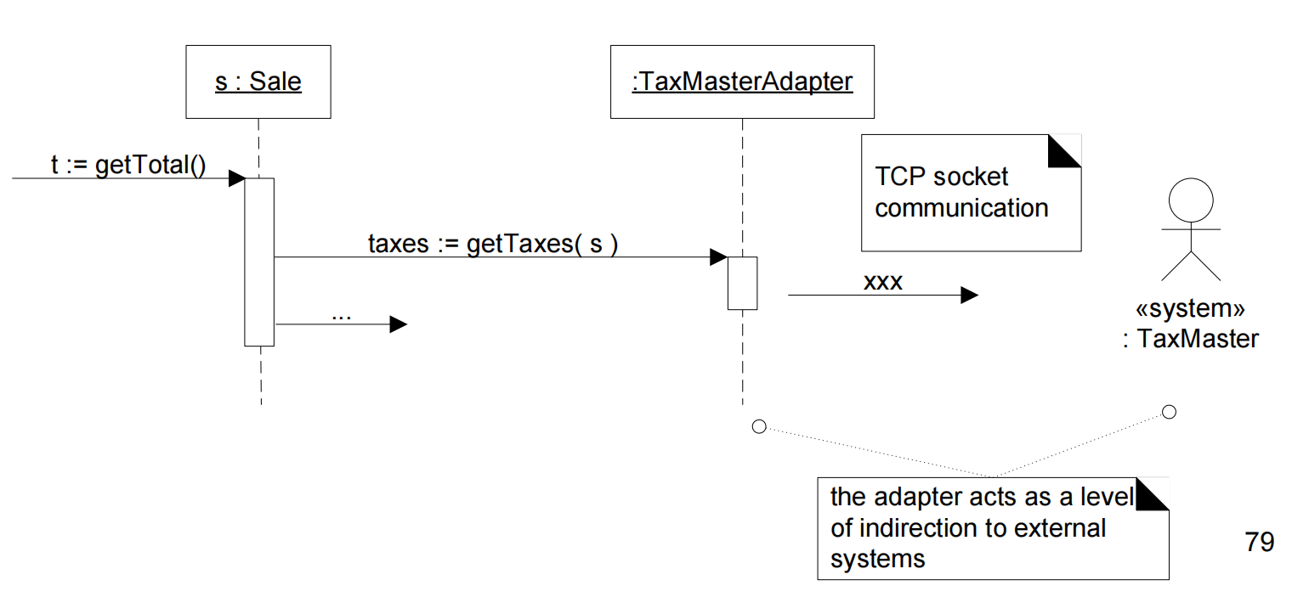
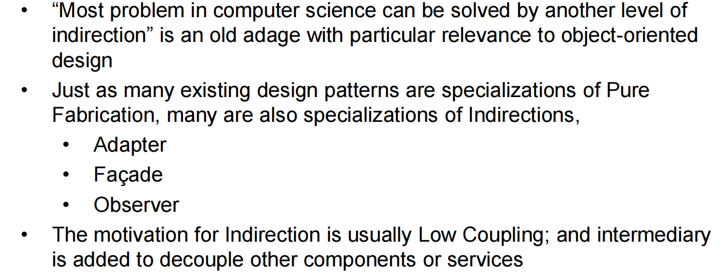

Slide 19
第二章 GoF 设计模式
序 GoF 设计模式概要
第一节 Adapter（适配器模式）
第二节 Singleton（单例模式）
第三节 Factory（工厂模式）
第四节 Strategy（策略模式）
第五节 部分设计模式回顾（Composite Observer Façade Proxy State）

Slide 20
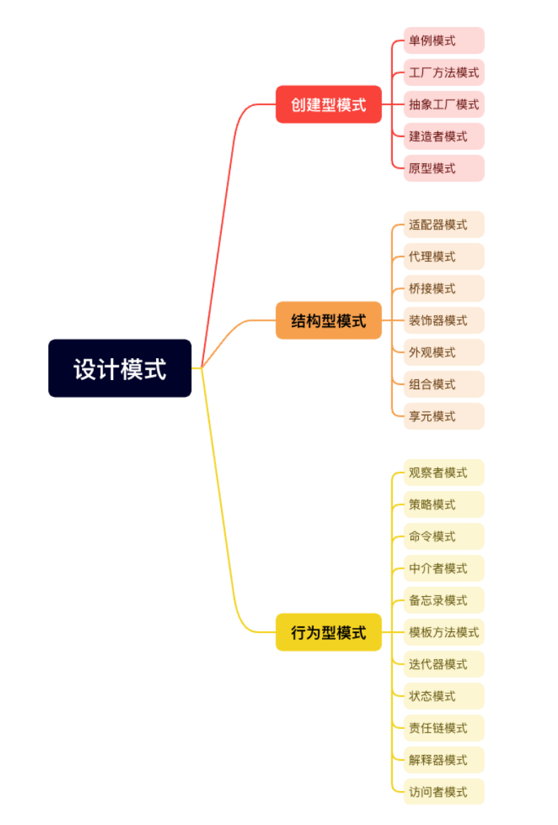
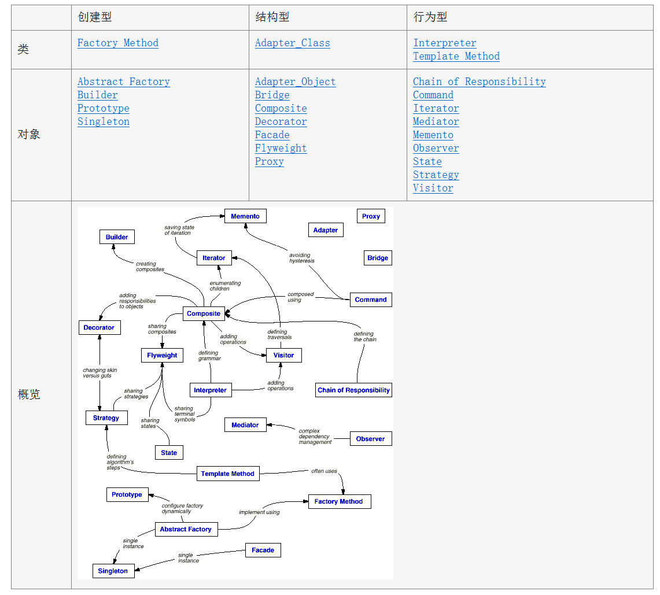

Slide 21
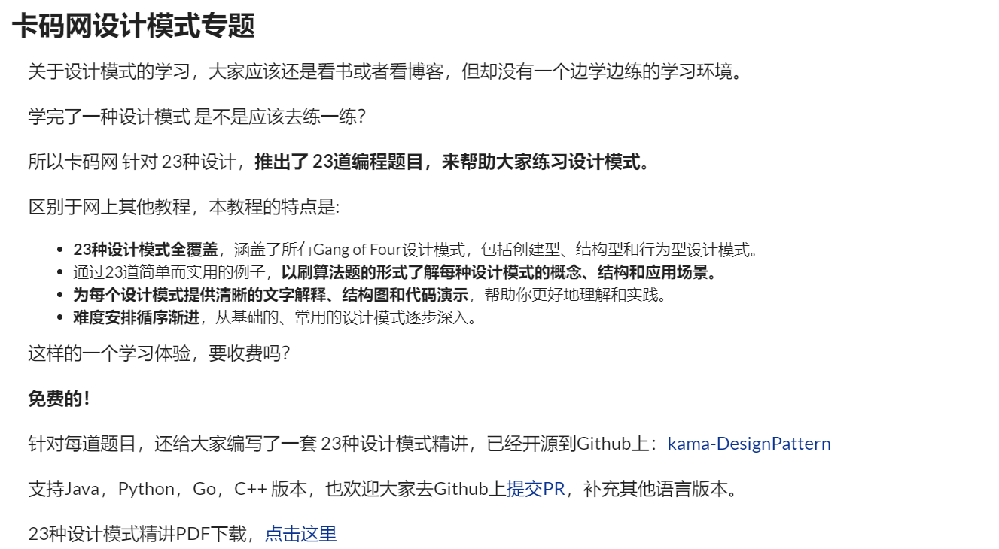


Slide 22
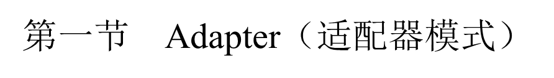
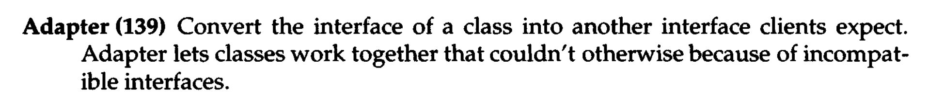
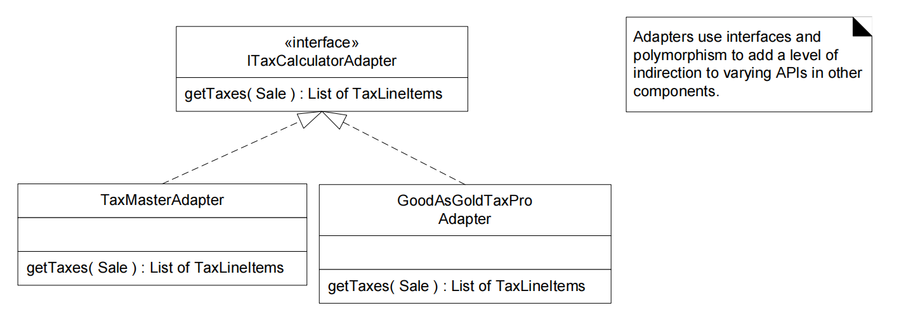

Slide 23
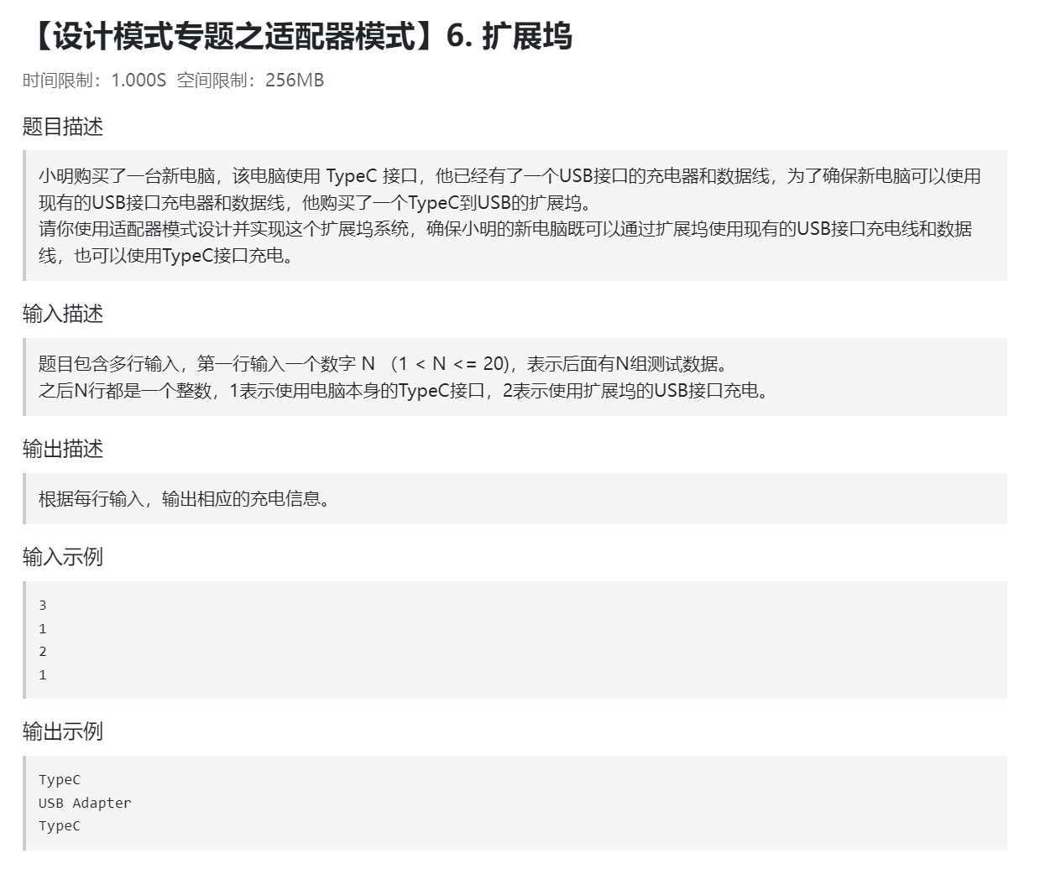
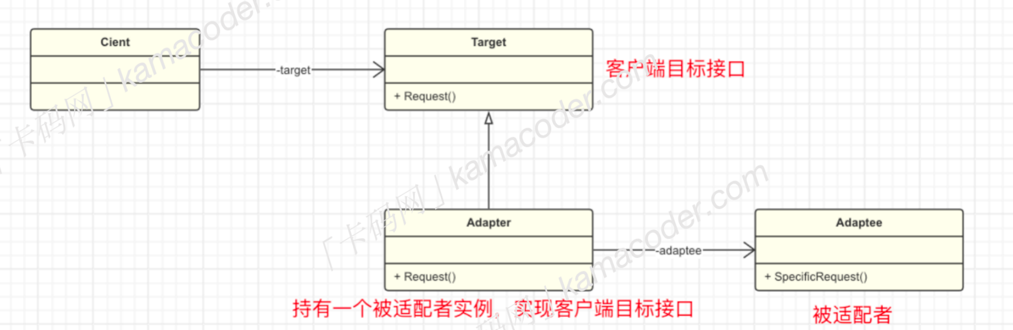

Slide 24
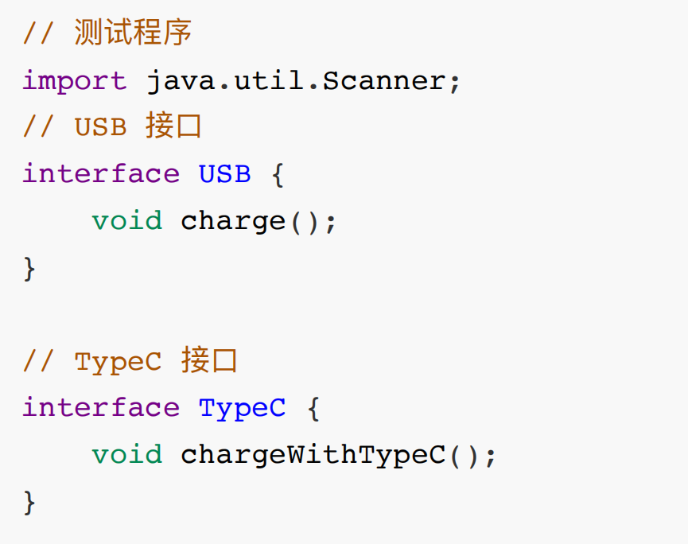
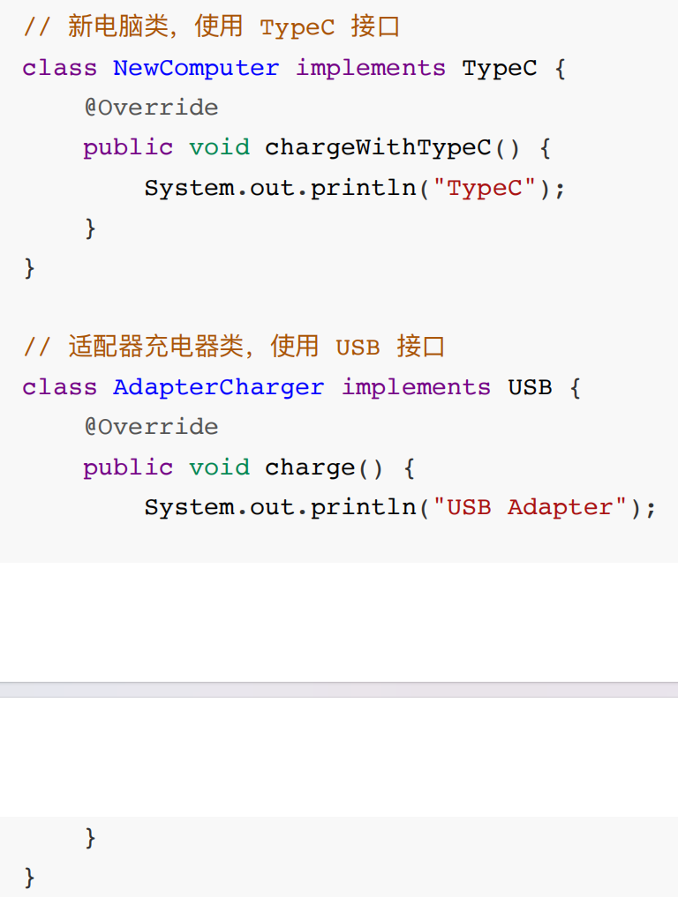
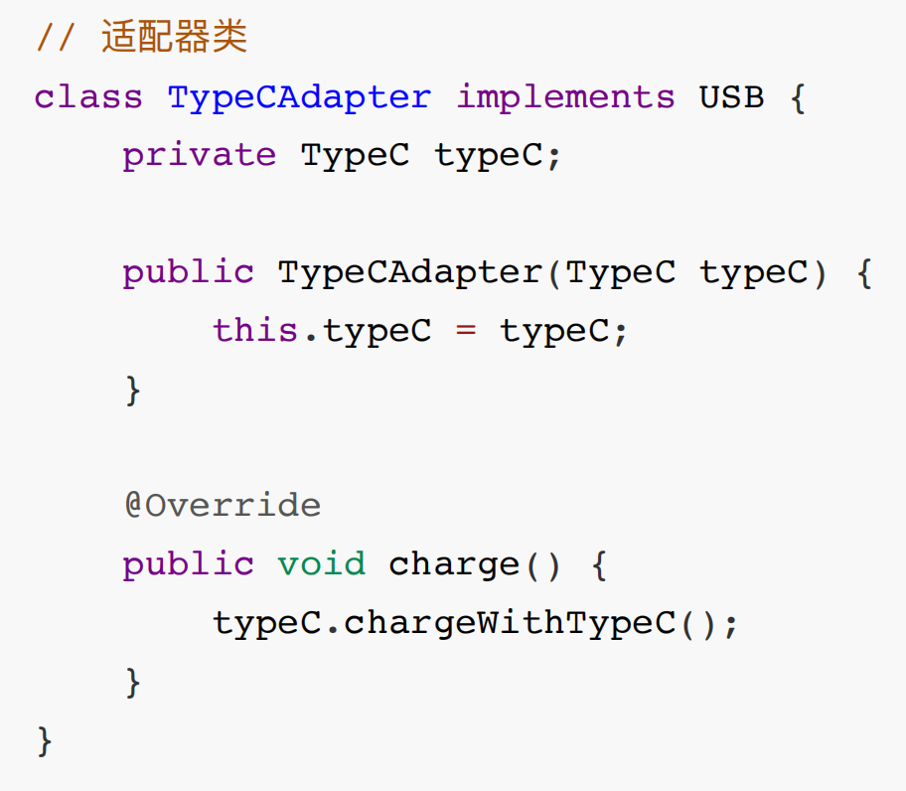

Slide 25
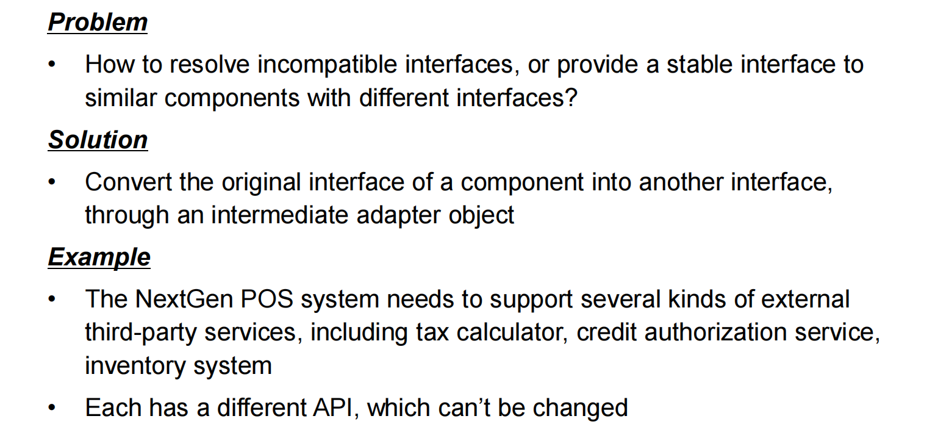
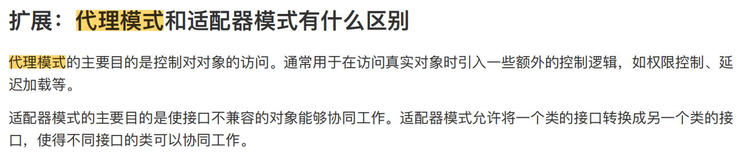

Slide 26
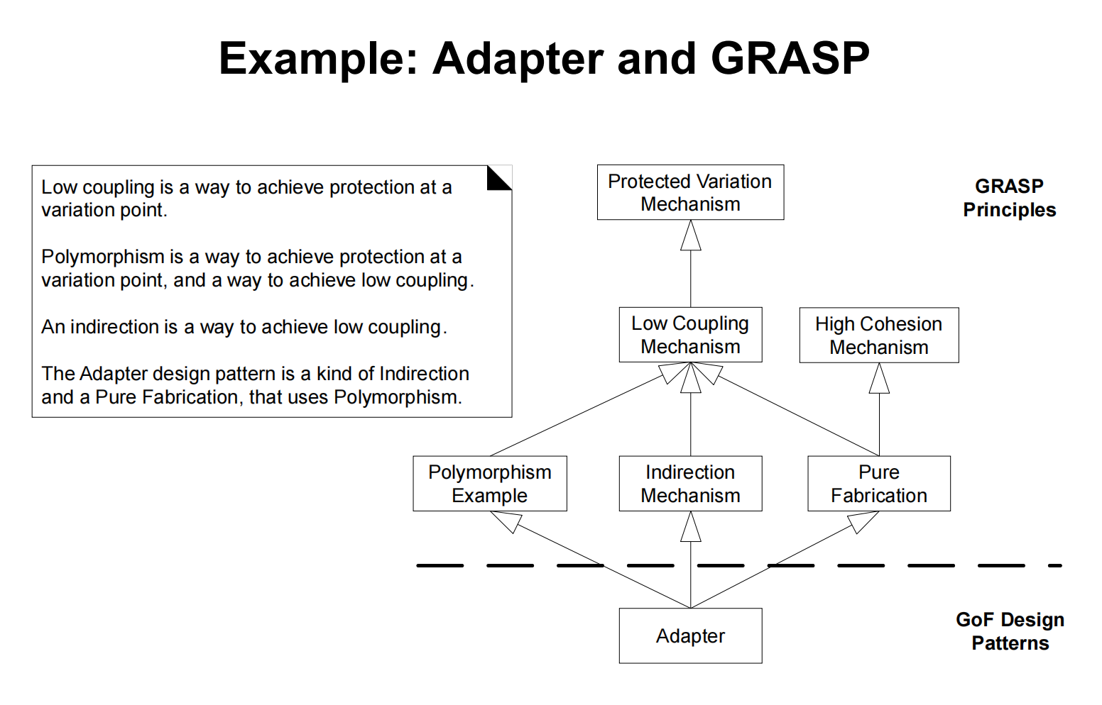

Slide 27
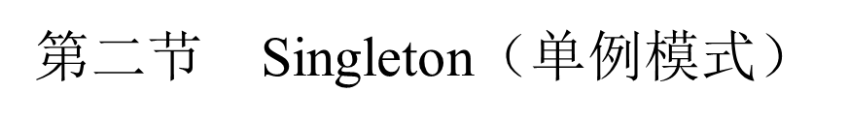
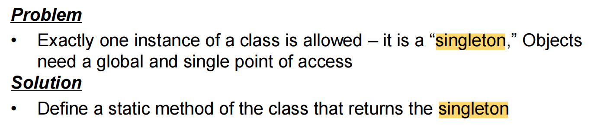
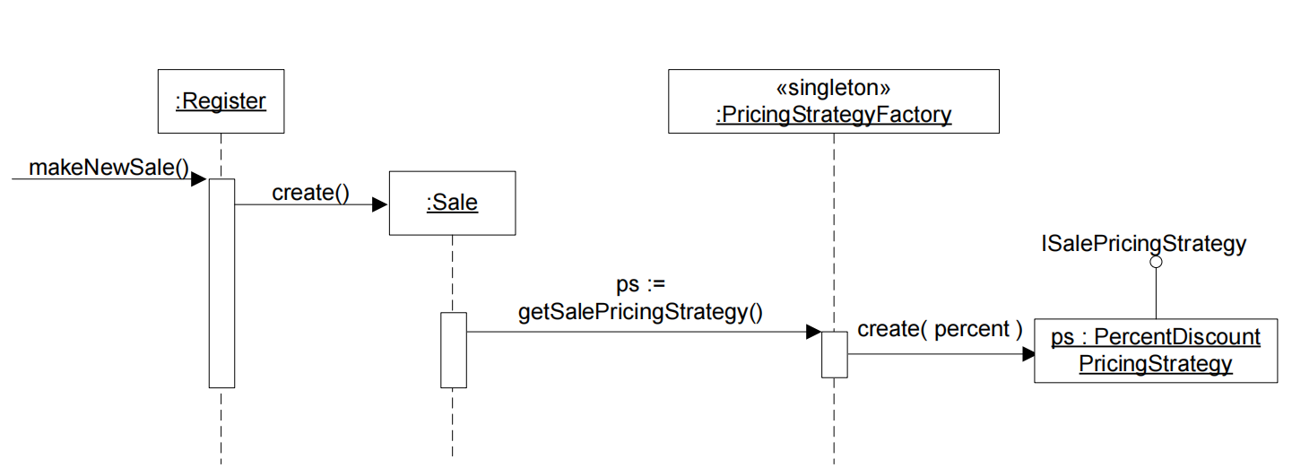

Slide 28
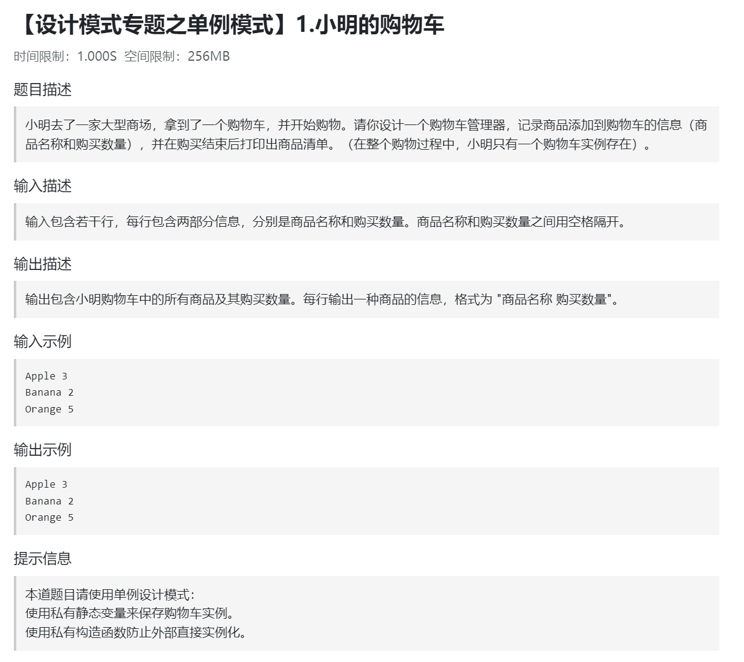
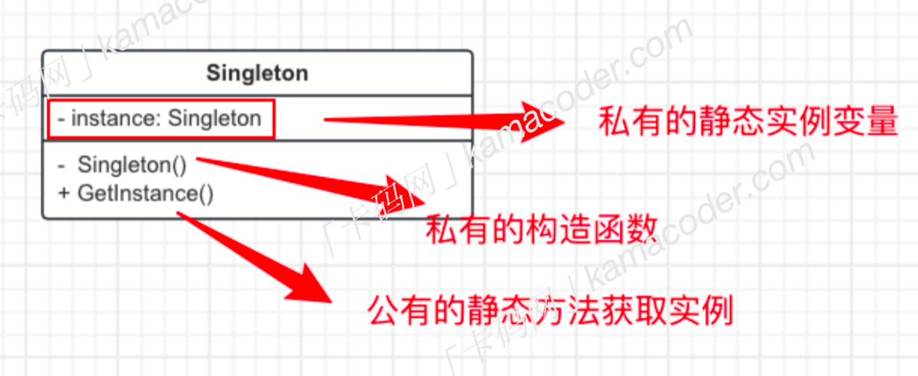

Slide 29
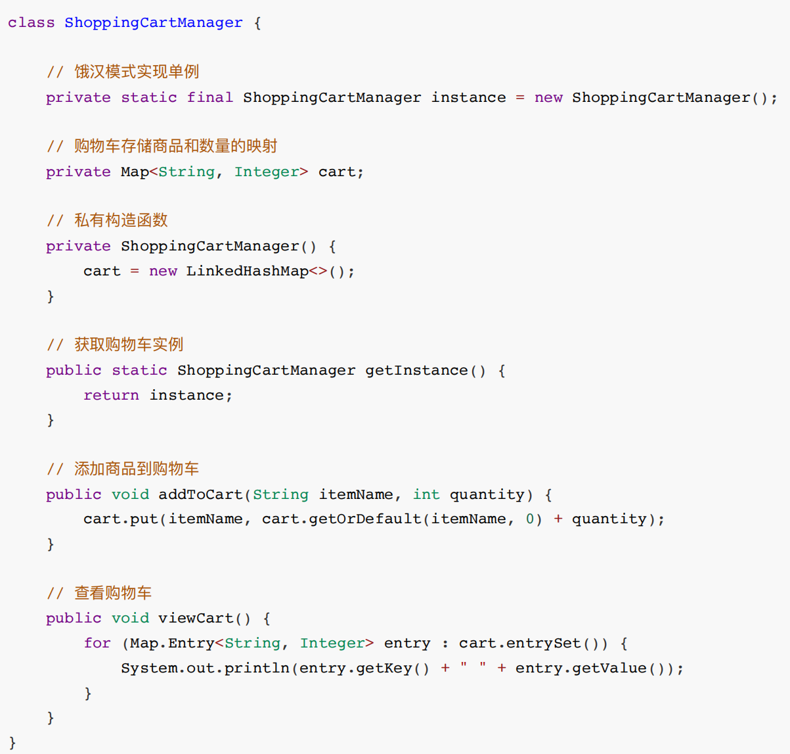

Slide 30
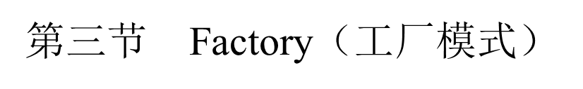
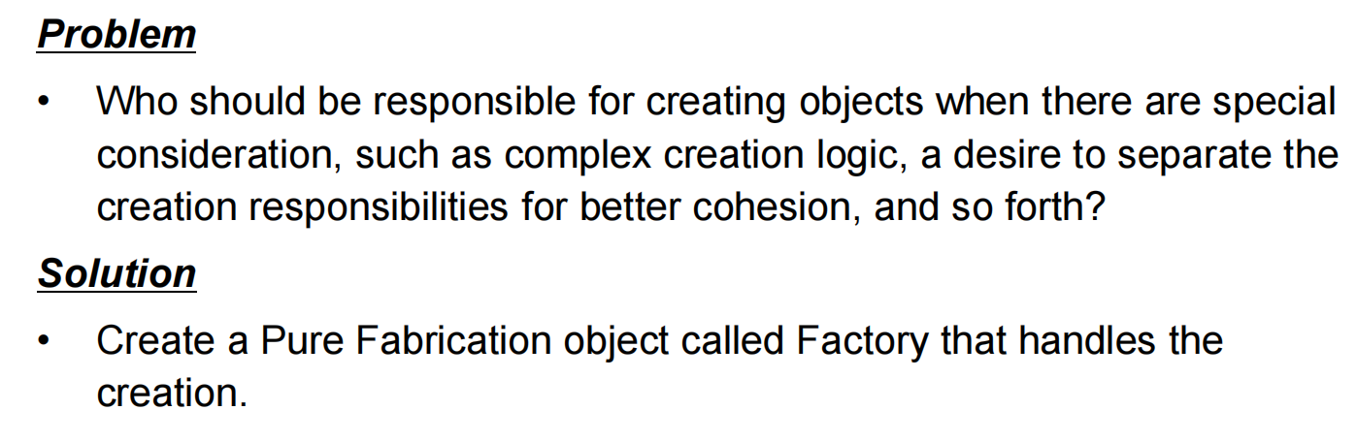
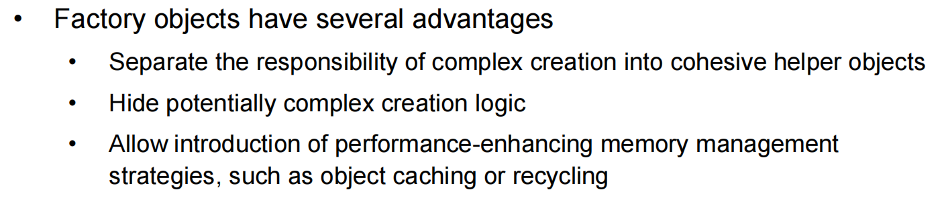

Slide 31
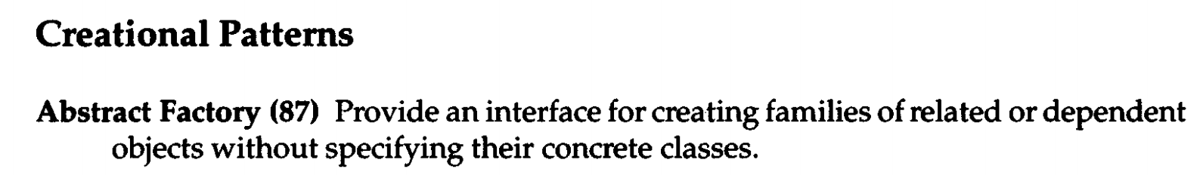





Slide 32



Slide 33



Slide 34




Slide 35




Slide 36

Composite

Slide 37



Slide 38


Slide 39



Slide 40



Slide 41



Slide 42



Slide 43




Slide 44





Slide 45



Slide 46



Slide 47



Slide 48





Slide 49
第三章 UML 软件设计分析与建模
第一节 Scenarios / Use-Case View（场景视图）
第二节 Logical View（逻辑视图）
第三节 Process View（过程视图）
第四节 Physical View（物理视图）

Slide 50


第一节 Scenarios / Use-Case View（场景视图）

Slide 51


Slide 52


Slide 53



Slide 54


Slide 55





Slide 56


Notes:
The correct answer is:
A. modeling the non-behavioral aspects such as data requirements, performance, and security.
Explanation:
Use cases are primarily used to capture and model the behavioral aspects of a system. This includes describing how users interact with the system to achieve specific goals or tasks. Therefore:
- Option B is correct: Use cases are used for capturing behavioral aspects of a system.
- Option C is correct: Use cases are used for capturing the functional aspect of a system.
- Option D is correct: Use cases can capture business processes at a high level.
However, option A is incorrect because use cases are not typically used for modeling non-behavioral aspects such as data requirements, performance, or security. These aspects are usually handled separately using other modeling techniques or requirements documentation.
Therefore, the correct answer is A.
1.
Here's a brief explanation of each option to clarify why B is the most appropriate choice:
A. Use-case Realization: This term refers to how a particular use case is realized in terms of interaction among collaborating objects within the system. It's more about the implementation rather than describing individual scenarios.
B. Use-case Scenario: This term is used to describe a specific instance or sequence of events within a use case. Each use case can have multiple scenarios representing different paths or variations of the process.
C. Use-case Model: This is a comprehensive model that includes all use cases for a system along with their relationships, actors, and interactions. It provides an overall picture of the system's functionality.
D. Use-case Specification: This document details all aspects of a use case, including its main flow, alternative flows, preconditions, postconditions, and any special requirements. It's more detailed and encompassing than individual scenarios.
Given the context of describing the design of one or more specific scenarios within a use case, Use-case Scenario is the most accurate term.

Slide 57
第二节 Logical View（逻辑视图）
Domain Model（概念类图）
Class Diagram（类图）

Slide 58


Slide 59


Slide 60


Slide 61


Slide 62


Explain all the relationships in class diagram.
is a part of

Slide 63







Slide 64



聚合关系（Aggregation）表示的是整体和部分的关系
整体和部分是可以分开的，它是关联关系的特例。
组合关系 (Composite) ⽤来描述整体和部分的关系，
但是，它规定了部分和整体是不能分开的。

Slide 65


Slide 66
第三节 Process View（过程视图）
State Diagram （状态图）
Sequence Diagram （顺序图）
Communication Diagram （通信图）
Activity Diagram （活动图）

Slide 67


Slide 68


Slide 69


Slide 70


Slide 71


Slide 72



Slide 73




Slide 74



Slide 75



Slide 76


Slide 77

Notes:
C

Slide 78



Slide 79


Slide 80

第四节 Physical View（物理视图）
Deployment Diagram
Q: What is deployment diagram?
It is a type of structural diagram that shows the physical configuration of runtime processing nodes and the artifacts deployed on them.
The deployment diagram shows:
Configuration of processing nodes at run-time.
Communication links between these nodes.
Component instances and objects that reside on them.

Slide 81
What is a node in deployment diagram ? List two various types of nodes.
In a deployment diagram, a node represents a physical element that exists at runtime and represents a computational resource. It can be a hardware device, such as a server or a computer, or a software execution environment, such as a virtual machine or a container.
① Processor Node: A processor node represents a hardware device that can execute software. It can be a physical server, a computer, or a virtual machine. Processor nodes typically run software applications or services.
② Device Node: A device node represents a physical device controlled by a processor node. It can be a peripheral device, such as a printer, a scanner, or a sensor, which is connected to the processor node and controlled by it.

Slide 82


Slide 83






Slide 84



第四章 历年常考简答题精选
What is design pattern ?
2. Please explain GRASP and GoF briefly.

Slide 85
3. What is an iteration? What are the benefits of Iterative Development?
An iteration in software development refers to a single development cycle in which a set of tasks or activities are completed. It is a single execution of a set of instructions that are to be repeated until a specified result is obtained.
① Critical risks are resolved before making large investments.
② Initial iterations enable early user feedback.
③ Testing and integration are continuous.
④ Objective milestones focus on the short term.
⑤ Progress is measured by assessing implementations.
⑥ Partial implementations can be deployed.
⑦ Each iteration produces an executable release, an additional increment of the system an it includes integration and test.

Slide 86



4.What is Liskov substitutability principle?
Give an example of breaking it and explain what sorts of problems breaking the principle may lead to. (6p).

Slide 87


Slide 88


5. What is Open-Close principle? Give an example of breaking it and explain what sorts of problems breaking the principle may lead to. (6p)

Slide 89


Slide 90

6. What is UML? List at least 3 benefits of developing with UML.

Slide 91

7. What is RUP? Please outline the 4 phases and 9 workflows of RUP. Please name and briefly describe the “4+1 view” of software architecture adopted in RUP.

Slide 92


Slide 93
8. Explain briefly the meaning of the following concepts (2p/concept)
OOA OOD OOP
Iterative and Incremental
Controller
High Cohesion
Low Coupling
Operation and Method
View
Model

Slide 94



Slide 95



Slide 96


Slide 97


Slide 98
第五章 软考真题荟萃（解答题）
回归课本：NextGen Post System
2009 上 ：ATM System
2010 上 ：Ticket Selling Control System
2012 上 ：Taobao System
2017 上 ：Online sales System for Electric Toys
https://blog.csdn.net/Catherinemin/article/details/130547972
2018 上 ：Electronic Toll Collection System
https://blog.csdn.net/Catherinemin/article/details/130556707
2019 上 ：Book Sales System
https://blog.csdn.net/Catherinemin/article/details/130578797
注意几个手机上的软件：12306、滴滴打车、拼多多
https://www.bilibili.com/read/cv18526892/

Slide 99



ATM System

Slide 100





Slide 101




Slide 102


(Score 5)

Slide 103


Taobao System

Slide 104



Slide 105




Slide 106


第六章 软考真题荟萃（选择题）
Notes:
C B A B D

Slide 107


Notes:
B A C D A

Slide 108

Notes:
C D B

Slide 109


Notes:
D A C
B D C

Slide 110


Notes:
A D C
B A D

Slide 111



Notes:
A B D

Slide 112



Notes:
D A D A

Slide 113

Notes:
A A C B
D C A

Slide 114


Notes:
B B

Slide 115


Notes:
B

Slide 116

Notes:
D C A

